Slide 1
AMAZON sales data analysis

Slide 2

indroduction

Slide 3
Sales management has become a critical function in today's competitive business environment. With the advent of globalization and the rapid growth of e-commerce, businesses are under immense pressure to optimize their sales strategies to not only meet increasing competition but also to streamline distribution methods, reduce operational costs, and maximize profits. Effective sales management is now essential for the survival and growth of any commercial or business enterprise.
One of the key aspects of modern sales management is leveraging data to gain insights into sales trends, customer behavior, and market dynamics. The ability to analyze sales data helps organizations make informed decisions, forecast future sales, and develop strategies that align with market demands

Slide 4
Procedure
In this project, we will employ the Extract-Transform-Load (ETL) process to analyze sales data from Amazon. The ETL process will involve:
Extracting the sales data from Amazon's dataset, which contains comprehensive records of sales transactions.
Transforming the raw data into a structured format suitable for analysis. This transformation will include data cleaning, normalization, and aggregation to ensure the accuracy and consistency of the dataset.
Loading the transformed data into a database or analytical tool for further examination.

Slide 5
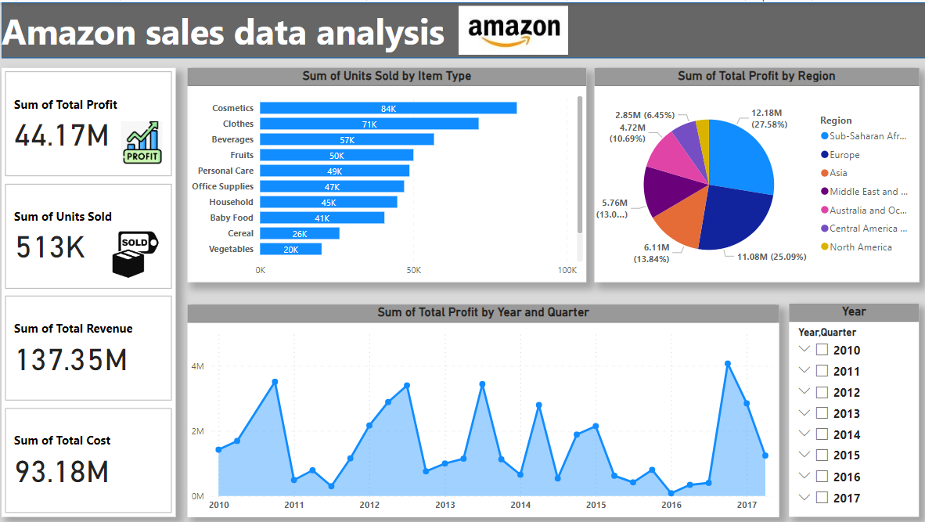
VISUALIZATION USING POWERBI

Slide 6

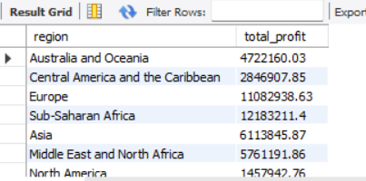
Data Querying using Sql

Slide 7

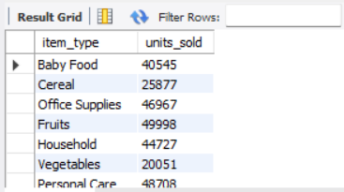

Slide 8
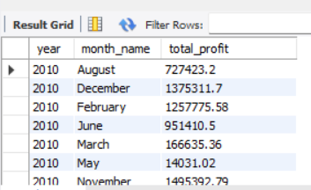

Slide 9
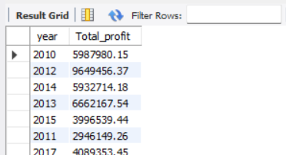

Slide 10
thankyou

